Slide 1
Leveraging Employee-Focused Leadership With Personality Testing
Speakers
Stephanie Carnes of The LMC Group Sami Elotmani of Destination MCO
Moderator
Kristen Carroll of The LMC Group

Slide 2
www.16personalities.com and click “take the test” or Google “Free MBTI test” and the link above should be the first result
Before We Get Started….

Slide 3
Leveraging Employee-Focused Leadership With Personality Testing
Sami Elotmani
VP Operations, destination mco, Orlando, fl
Stephanie carnes
client specialist, the lmc group

Slide 4
www.16personalities.com and click “take the test” or Google “Free MBTI test” and the link above should be the first result
Before We Get Started….

Slide 5
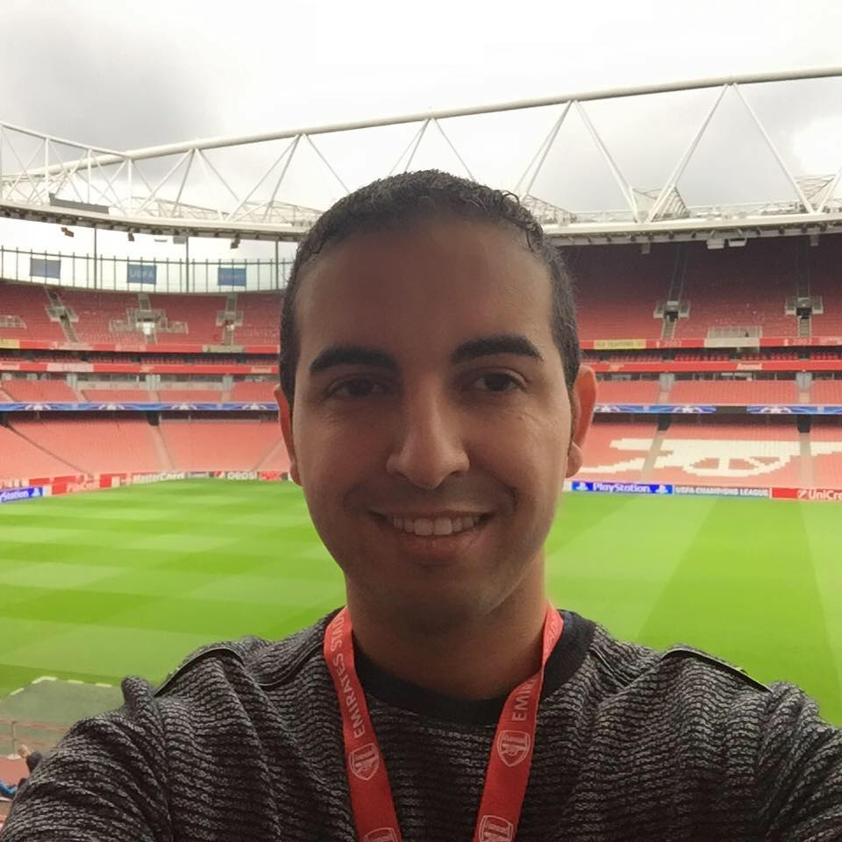
INTRODUCTION
Sami Elotmani – Destination MCO
Stephanie Carnes – The LMC Group
Notes:
Introductions
FB profile photos – extrovert vs. introvert

Slide 6
LEARNING GOALS
Session Objective
Intro to Situational Leadership
Intro to MBTI (Myers-Briggs Type Indicator)
Using MBTI & Situational Leadership Together
Q & A

Slide 7
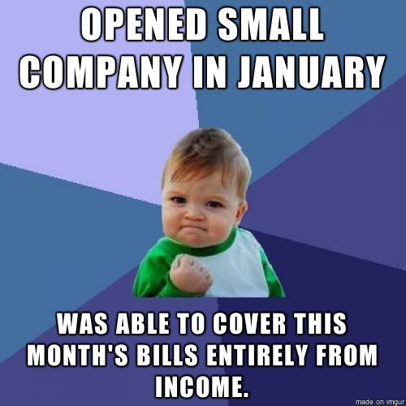
SESSION OBJECTIVE
Notes:
- Before we start, let me help you remove one of the biggest VALID excuses we all use as small business owners and managers in this industry: It’s a 24/7/365 kind of grind – it never stops! We ALL know that…
- With a show of hand, how many of you had to let go of an employee because they could not handle the nature of the business, the grind? They preferred a cushier 9-5 M-F job? Darn Millennials, right?
Okay, that happens to all of us.
- How about this one: With a show of hand, how many of you lost an employee, who would have probably made a GREAT Manager for you one day… AND you lost them because you didn’t have the time to support them and give them the attention they need to get there?
- Now, this session isn’t about TIME MANAGEMENT, we would need more than an hour for that!
- What we would like to accomplish today is to give you a framework for understanding the different personality types that we come across daily, both when dealing with employees OR clients – even in our social and family life. We are hoping that by becoming more aware of the different personality types out there, you can take that information and adjust your leadership style to each person whenever possible.

Slide 8
SITUATIONAL LEADERSHIP
The Situational Leadership® model is an easy-to-understand, practical framework that helps managers:
Diagnose the needs of their people and…
Provide the appropriate leadership style to meet those needs.
54% of leaders use one leadership style!
50% of the time, leaders are using the wrong leadership style!

Slide 9
SITUATIONAL LEADERSHIP
2 Key Questions:
What is the SKILL LEVEL of the employee?
What is the MOTIVATION LEVEL of the employee?
Notes:
Keep in mind that these are not static answers – For example, a certain employee’s Dispatching skills may be excellent. Yet, they could be horrible at handling chauffeurs. Does that example sound familiar? The point we are trying to make is that you have to judge each particular conversation based on that employee’s skill level for THAT discussion point, NOT their overall skill level.
Also keep in mind that, for most people, motivation ebbs and flows. So, someone who may think is highly motivated today could become disillusioned very quickly – so it’s important that, as leaders, we keep our finger on the pulse of each employee as often as possible.

Slide 10
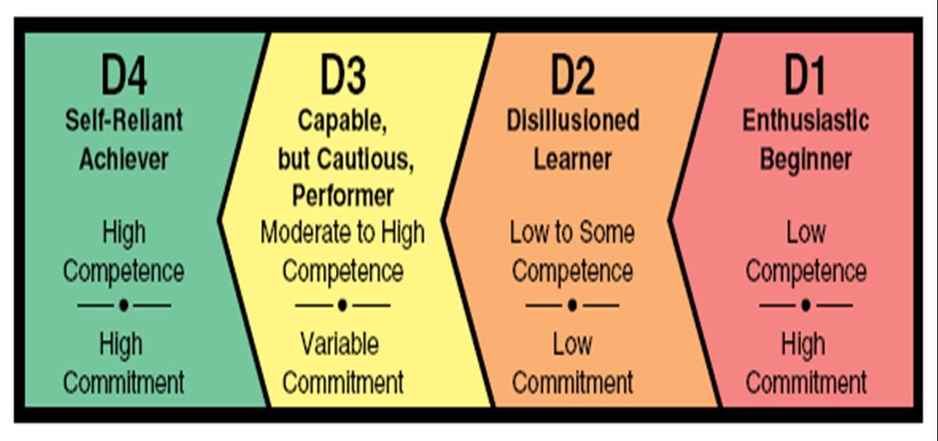
SITUATIONAL LEADERSHIP
Developed
Developing
Notes:
Okay, So most new employees tend to come in with High Commitment and Low Competence. Yes, low competence even if they have previous experience in the same job - For example, they may know Dispatch but they still have to learn the way your company does things, how you handle driver assignments etc.
Most of our employees tend to be in the D2 & D3 – if we are lucky, most of them are in the D3, right?
How many of us have employees that may be in D2? That’s a dangerous quadrant isn’t it?
Situational Leadership teaches us how to use this tool to decide WHERE an employee is from a development perspective and then DECIDE what leadership style best fits the situation.

Slide 11
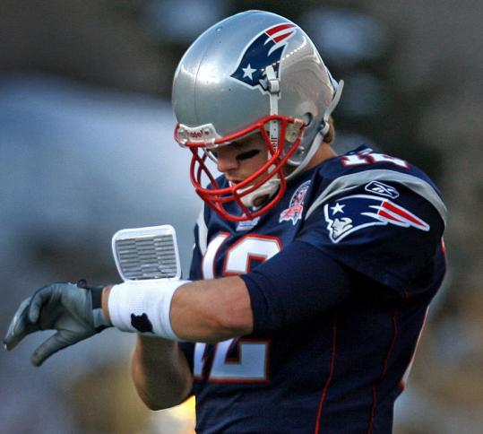
SITUATIONAL LEADERSHIP
Notes:
So, you may be wondering: Sami, are you asking me to keep this play-call chart handy at all times? No, not at all!
We are simply asking you to be aware of where an individual is on the development spectrum before you make a decision on how you train/coach them within a particular situation.
Most of us know to handle new employees – we all try to be as detailed and directive as possible during training, right? That’s why we all either have training manuals or aspire to have them soon – training manuals are designed to DIRECTIVE.
Where most of us struggle with using the right leadership style is D4, D3 and, perhaps most importantly D2…. Disillusioned employees are very costly to any company, big or small.

Slide 12
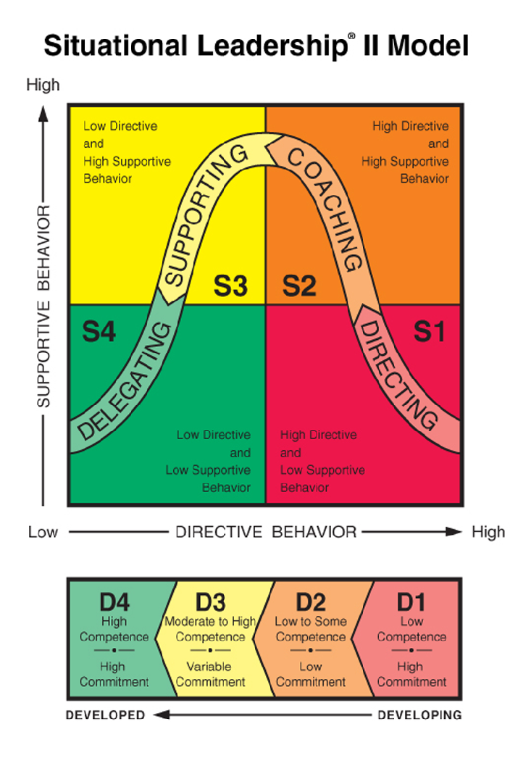
SITUATIONAL LEADERSHIP
Participating
Selling
Delegating
Telling
Notes:
So, by looking at the 4 different development levels at the bottom, we can decide which leadership style is best suited for a particular employee, but as we mentioned before, a particular situation.
Let’s talk specific examples for each quadrant:
1- The first one easy: New employees tend to be low in competence and high in commitment. Your job is to get them through training as efficiently as possible while still maintaining their enthusiasm.
2- Let’s talk about an employee who is in D2: showing low commitment – someone who is effectively disgruntled – we all have those, right?
- We all fall into the trap of “Doing Nothing” - Maybe we think the situation will work itself out eventually? Either they get better or they will quit, right?
- You know what’s worst that an employee that “quits and LEAVES”? An employee that “QUITS and STAYS” – it is our job as leaders to either Coach them UP or coach them OUT….
- The first step in that is to try to figure out WHAT CAUSED THE DROP IN MOTIVATION? Is it something we can fix internally? Is it job-specific?
- The next step is to discuss the task at hand – what can you do as a leader to “SELL” this employee on the importance of getting this particular task done, right? Making sure that you are equally focusing
on the task AS WELL AS supportive behavior. This employee may already have the skill necessary and simply needed more 1-on-1 time with you, their leader….
In my experience, if this employee is redeemable, just the fact that you are taking the time to meet with the employee 1-on-1 for a coaching session goes a long way in lifting their spirit…
- Also, avoid linking the COACHING session immediately after a service incident took place. We ALL do it: an incident happens where an employee did something wrong that caused us to COMP a service (Data entry error, dispatcher wasn’t keep an eye on a late chauffeur, etc.). So, we pull them to our office immediately to talk about it – You know… “TO FIX IT OR FIX THE PERSON”….Raise your hand if you have done this before… How about this week?
- This session is more likely to achieve the objective if it takes place without the emotional baggage of a service incident.

Slide 13
Situational Leadership Shortcuts
Development Levels
Variable
MBTI Personality Types
Fixed
Motivation
Compensation
Career Path
Conflict Resolution
Communication

Slide 14
Why MBTI?

Slide 15
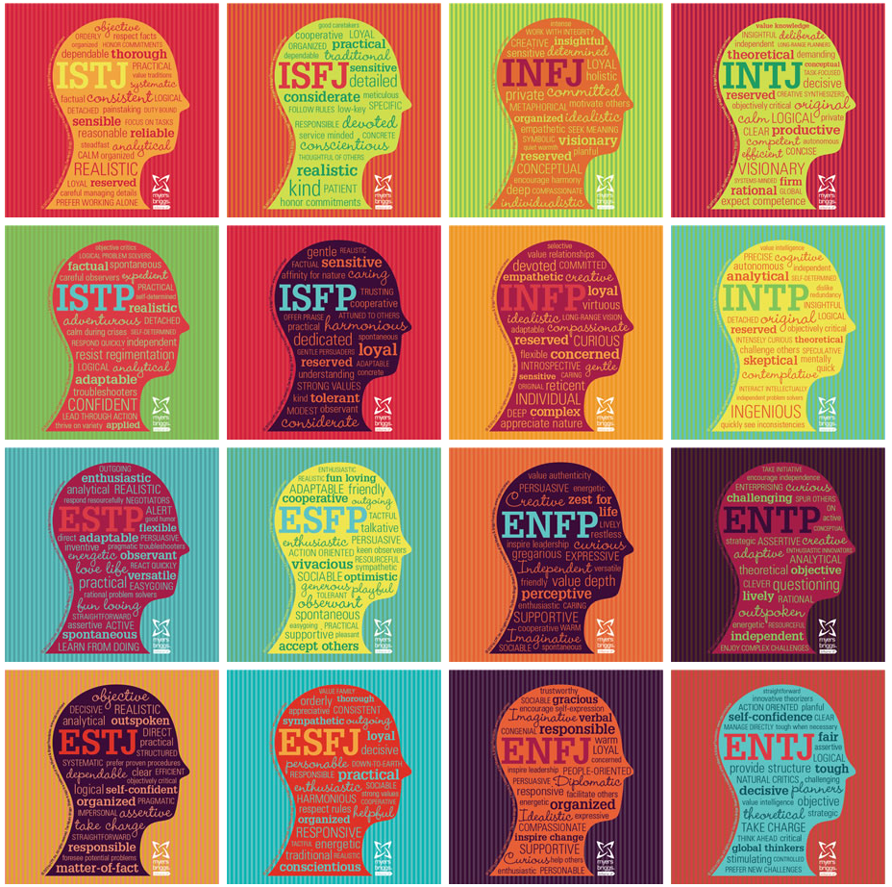
MBTI Types

Slide 16
MBTI Prayers

Slide 17
VERBAL TYPING

Slide 18
EXTRAVERSION VS. INTROVERSION
HOW WE DIRECT AND RECEIVE ENERGY

Slide 19
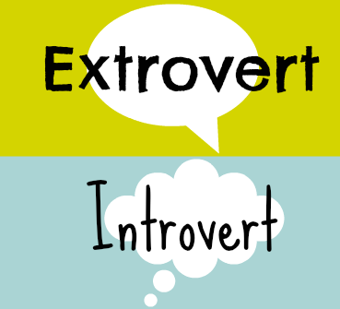
EXTRAVERSION vs. INTROVERSION
Extroverts TEND TO SPEAK IN ORDER TO THINK
Vs.
INTROVERTS TEND TO THINK IN ORDER TO SPEAK

Slide 20
SENSING VS. INTUITION
HOW WE TAKE IN INFORMATION

Slide 21
Let’s Play a Game!

Slide 22
THINKING VS. FEELING
HOW WE MAKE DECISIONS

Slide 23
Thinking vs. Feeling

Slide 24
JUDGING VS. PERCEIVING
HOW WE ORGANIZE OUR OUTSIDE WORLDS

Slide 25
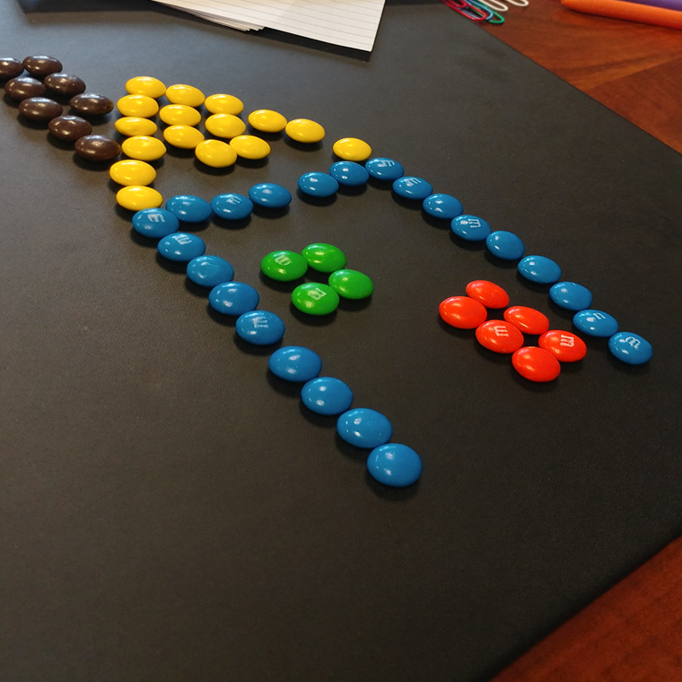
THE M&M CHALLENGE: JUDGERS

Slide 26
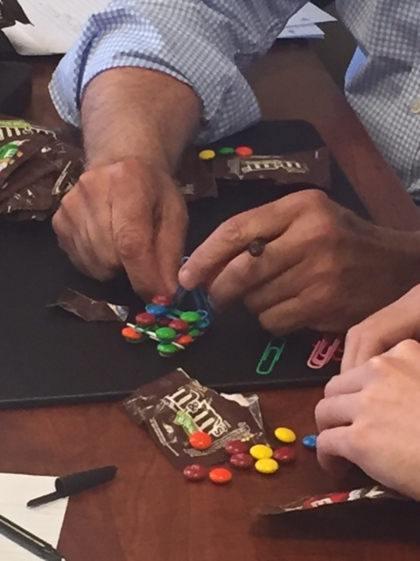
THE M&M CHALLENGE: PERCEIVERS

Slide 27
Judgers vs. Perceivers

Slide 28
Using MBTI & Situational Leadership

Slide 29
Q & A
Sami Elotmani, DMCO
sami@destinationmco.com
Stephanie Carnes, LMC
stephanie@lmc.group

Slide 30
Thank you for joining us!
For those who’ve preregistered for the Operator Mentoring Program, head next door to Osceola C, where pre-seating is already underway. Otherwise, we’ll see you at our Hawaiian Luau Party on the Coquina Lawn at 8:30 p.m.

